Slide 1
USMC Robotics Club 2017
1st class of Arduino Module

Slide 2
Introduction: What is Arduino?
Arduino is an open-source electronics software.
It is built for artists, designer, hobbyists and people who love designing and creating interactive objects!
It was founded in the Interaction Design Institute Ivrea (IDII) in Ivrea, Italy.
Similarly, in our case, we use it for programming.

Slide 3

What is Arduino?
The official logo of Arduino

Slide 4
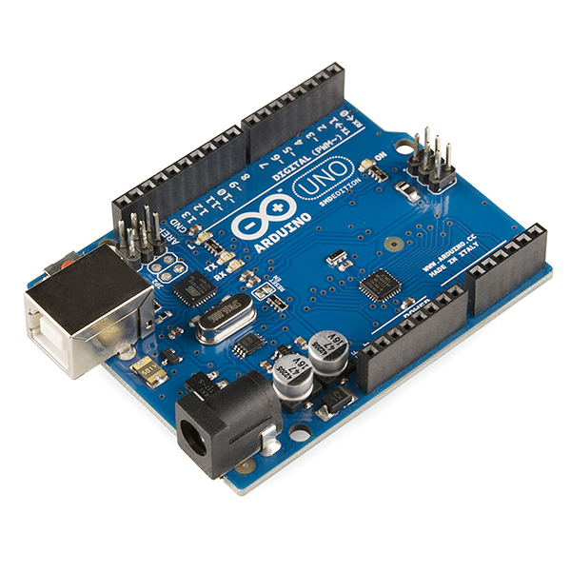
Arduino microcontroller
In learning to use Arduino, we will each be using an Arduino UNO R3 module. The module is as shown below.
It is a programmable circuit board and it utilizes a much simpler version of the dreaded C++ programming language.

Slide 5
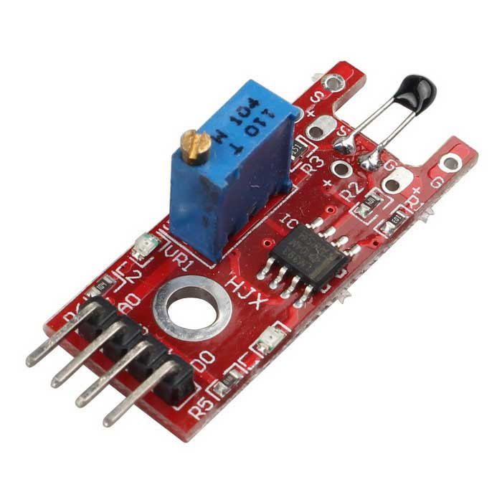
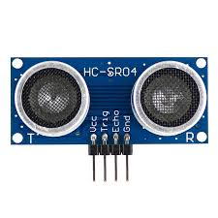
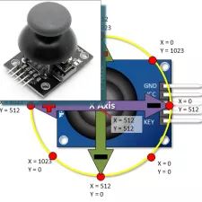
Arduino input sensors
Arduino Inputs Sensors range from temperature sensors, ultrasonic sensors, voltage sensors and a variety of switches. In fact, what makes it interesting is that you can even use PS2 analog sticks as controlling devices in Arduino!

Slide 6
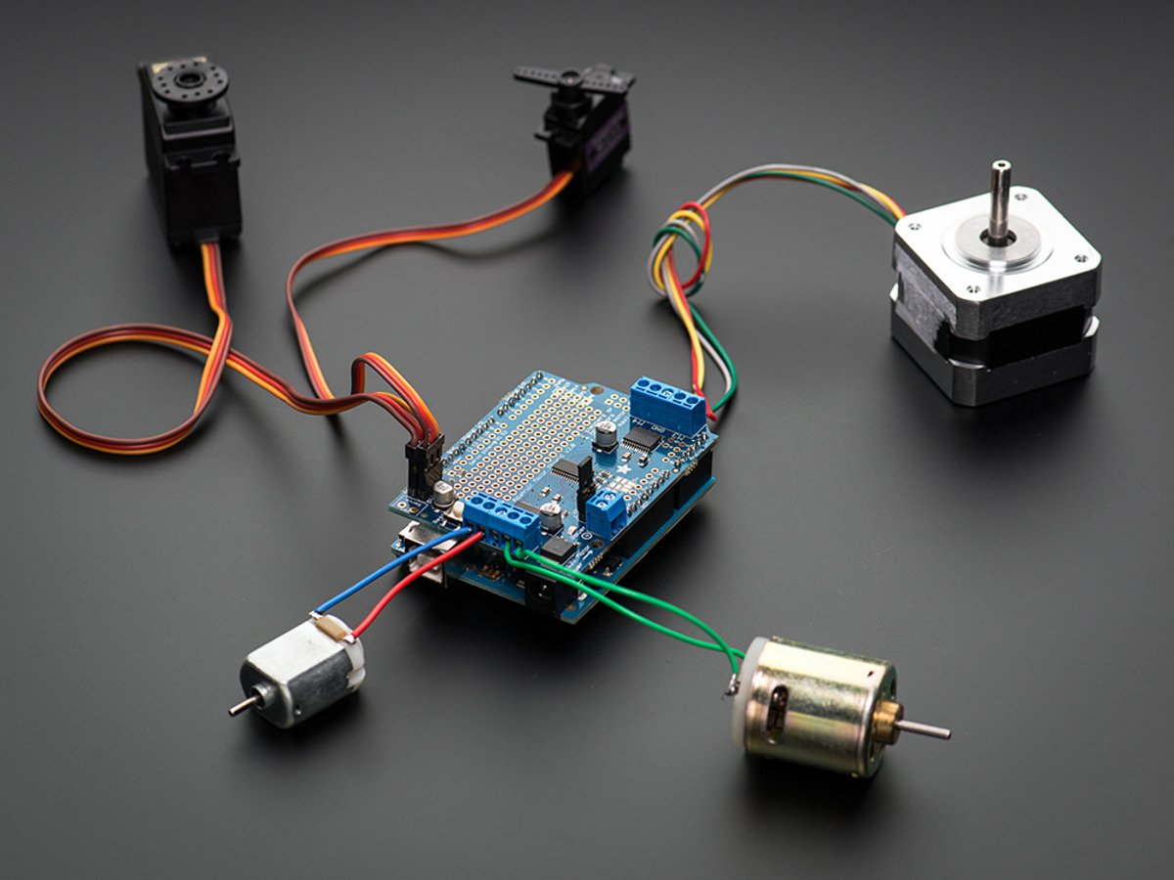
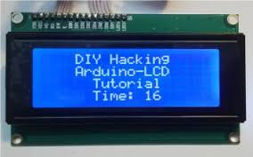
Arduino output devices
In Arduino, having input devices alone will not help us accomplish anything if the robots or devices built have no output devices. So, a few examples of output devices used in Arduino include a display screen, light or a motor.

Slide 7

Beginning…
Now let us start! In your groups, you are provided with an Arduino UNO R3 module to work on.
Further instructions will be provided
Please handle them carefully and responsibly.

Slide 8
Downloading the Arduino software
On your laptops, go to www.arduino.cc.
On the menu bar at the top of the page, click the “Software” button.
On that page, download the latest version of Arduino which is Ver 1.8.5. according to the compatibility of the operating system of your device.
Install the programme and run it when installation is complete.
Further instructions will be given.

Slide 9
References
http://forefront.io/a/beginners-guide-to-arduino/
https://www.arduino.cc/en/Main/Software

